Slide 1
CPSC331 - Spring 2019 Tutorial 03
Khobaib Zaamout

Slide 2
Question 6: proof f(n)=n bound function
Write a proof that the function f(n) = n is a bound function for this recursive algorithm:
integer[] fibPair (integer n) { // Assertion: A nonnegative integer n has been given as input
1. integer[] F = new integer[2]
2. if (n == 0) {
3. F[0] := 0
4. F[1] := 1
} else {
5. integer[] oldF := fibPair(n − 1)
6. F[0] := oldF[1]
7. F[1] := oldF[0] + oldF[1]
}
8. return F
}

Slide 3
Question 6: proof f(n)=n bound function
Work Area:
Background: A bound function for a recursive algorithm is:
Mathematical function defined on inputs and global data of precondition
Integer-valued
The function value decrease by at least one with every recursive call
If function value ≤ 0, then no recursive call

Slide 4
Question 6: proof f(n)=n bound function
Work Area:
Background: A bound function for a recursive algorithm is:
The precondition is: A nonnegative integer n is given as input.
Mathematical function defined on inputs and global data of precondition
Integer-valued
The function value decrease by at least one with every recursive call
If function value ≤ 0, then no recursive call

Slide 5
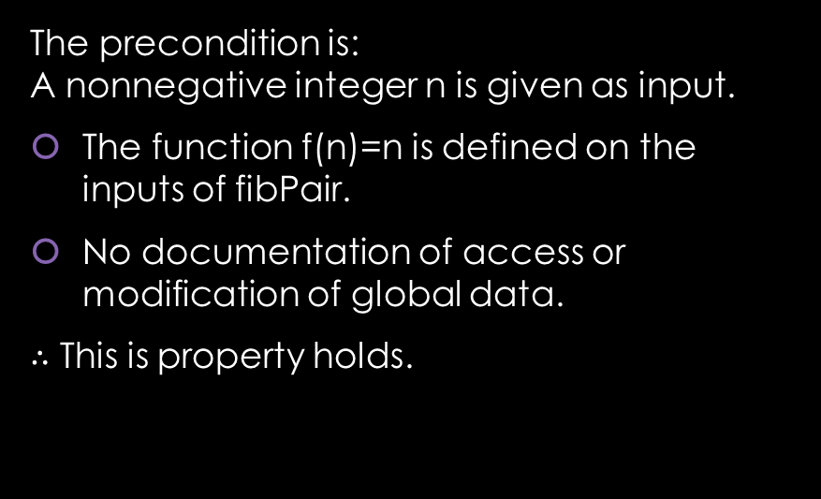
Question 6: proof f(n)=n bound function
Work Area:
Background: A bound function for a recursive algorithm is:
The precondition is: A nonnegative integer n is given as input.
The function f(n)=n is defined on the inputs of fibPair.
No documentation of access or modification of global data.
$∴$ This is property holds.
Mathematical function defined on inputs and global data of precondition
Integer-valued
The function value decrease by at least one with every recursive call
If function value ≤ 0, then no recursive call

Slide 6
Question 6: proof f(n)=n bound function
Work Area:
Background: A bound function for a recursive algorithm is:
The precondition is: A nonnegative integer n is given as input.
Mathematical function defined on inputs and global data of precondition
Integer-valued
The function value decrease by at least one with every recursive call
If function value ≤ 0, then no recursive call

Slide 7
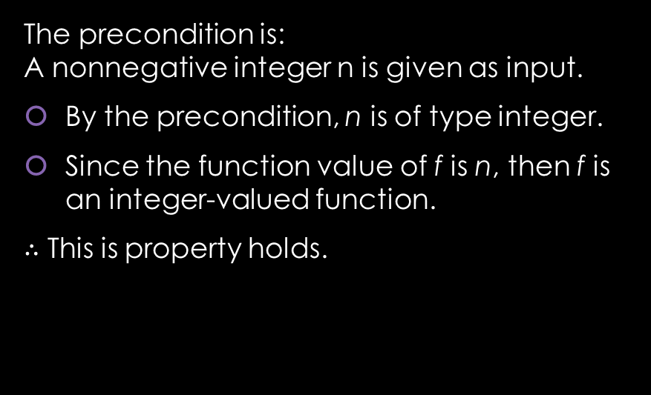
Question 6: proof f(n)=n bound function
Work Area:
Background: A bound function for a recursive algorithm is:
The precondition is: A nonnegative integer n is given as input.
By the precondition, n is of type integer.
Since the function value of f is n, then f is an integer-valued function.
$∴$ This is property holds.
Mathematical function defined on inputs and global data of precondition
Integer-valued
The function value decrease by at least one with every recursive call
If function value ≤ 0, then no recursive call

Slide 8
Question 6: proof f(n)=n bound function
Work Area:
Background: A bound function for a recursive algorithm is:
The recursive call is:
5. integer[] oldF := fibPair(n − 1)
Mathematical function defined on inputs and global data of precondition
Integer-valued
The function value decrease by at least one with every recursive call
If function value ≤ 0, then no recursive call

Slide 9
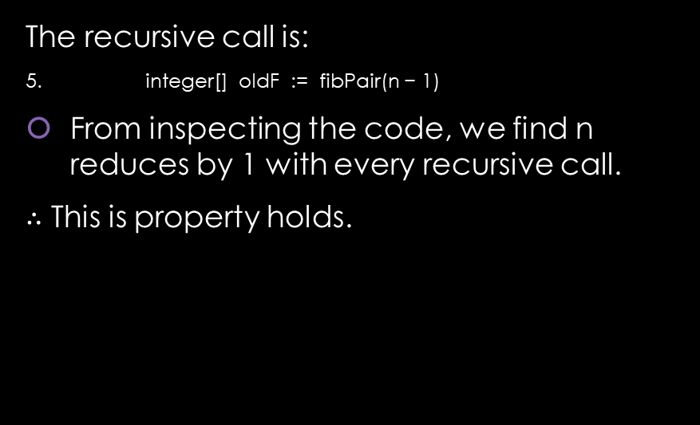
Question 6: proof f(n)=n bound function
Work Area:
Background: A bound function for a recursive algorithm is:
The recursive call is:
5. integer[] oldF := fibPair(n − 1)
From inspecting the code, we find n reduces by 1 with every recursive call.
$∴$ This is property holds.
Mathematical function defined on inputs and global data of precondition
Integer-valued
The function value decrease by at least one with every recursive call
If function value ≤ 0, then no recursive call

Slide 10
Question 6: proof f(n)=n bound function
Work Area:
Background: A bound function for a recursive algorithm is:
The precondition is: A nonnegative integer n is given as input.
Mathematical function defined on inputs and global data of precondition
Integer-valued
The function value decrease by at least one with every recursive call
If function value ≤ 0, then no recursive call

Slide 11
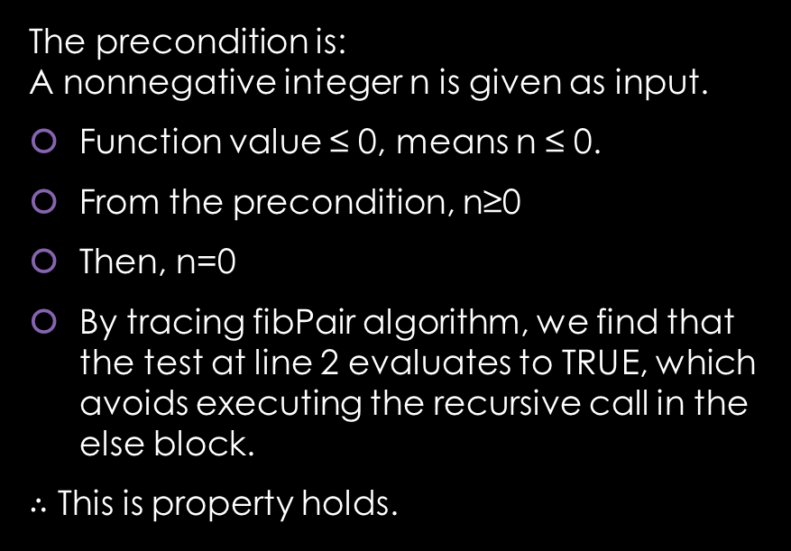
Question 6: proof f(n)=n bound function
Work Area:
Background: A bound function for a recursive algorithm is:
The precondition is: A nonnegative integer n is given as input.
Function value ≤ 0, means n ≤ 0.
From the precondition, n≥0
Then, n=0
By tracing fibPair algorithm, we find that the test at line 2 evaluates to TRUE, which avoids executing the recursive call in the else block.
$∴$ This is property holds.
Mathematical function defined on inputs and global data of precondition
Integer-valued
The function value decrease by at least one with every recursive call
If function value ≤ 0, then no recursive call

Slide 12
Question 6: proof f(n)=n bound function
Work Area:
Background: A bound function for a recursive algorithm is:
Since all properties hold, it follows that f(n)=n is a bound function for fibPair algorithm.
Mathematical function defined on inputs and global data of precondition
Integer-valued
The function value decrease by at least one with every recursive call
If function value ≤ 0, then no recursive call

Slide 13
Question 7: proof fibPair is correct
Write a proof that this algorithm correctly solves the “Fibonacci Pair Computation” problem.
integer[] fibPair (integer n) { // Assertion: A nonnegative integer n has been given as input
1. integer[] F = new integer[2]
2. if (n == 0) {
3. F[0] := 0
4. F[1] := 1
} else {
5. integer[] oldF := fibPair(n − 1)
6. F[0] := oldF[1]
7. F[1] := oldF[0] + oldF[1]
}
8. return F
}

Slide 14
Question 7: proof fibPair is correct
Work Area:
Background: An algorithm is correct if:
If precondition is satisfied and algorithm is executed, then:
eventually the execution ends, and
postcondition is satisfied

Slide 15
Question 7: proof fibPair is correct
Work Area
Background: An algorithm is correct if:
To prove these properties, we use the standard form of mathematical induction:
Basis
Inductive Step:
Inductive Hypothesis
Inductive Claim
Proof Steps
Proof Closure
If precondition is satisfied and algorithm is executed, then:
eventually the execution ends, and
postcondition is satisfied

Slide 16
Question 7: proof fibPair is correct
Work Area
Background: An algorithm is correct if:
1. Basis:
If precondition is satisfied and algorithm is executed, then:
eventually the execution ends, and
postcondition is satisfied

Slide 17
Question 7: proof fibPair is correct
Work Area
Background: An algorithm is correct if:
1. Basis: by precondition, n≥0. We consider an execution of fibPair when n=0
Only lines 1-4 and line 8 are executed.
At line 8, the algorithm execution ends.
An integer array F is returned, where F[0]=0=F₀=F_{n} and F[1]=1=F₁=F_{n+1}. F satisfies the postcondition.
If precondition is satisfied and algorithm is executed, then:
eventually the execution ends, and
postcondition is satisfied

Slide 18
Question 7: proof fibPair is correct
Work Area
Background: An algorithm is correct if:
2. Inductive Step:
If precondition is satisfied and algorithm is executed, then:
eventually the execution ends, and
postcondition is satisfied

Slide 19
Question 7: proof fibPair is correct
Work Area
Background: An algorithm is correct if:
2. Inductive Step:
Let k be an integer such that k ≥ 0.
Inductive Hypothesis:
If precondition is satisfied and algorithm is executed, then:
eventually the execution ends, and
postcondition is satisfied

Slide 20
Question 7: proof fibPair is correct
Work Area
Background: An algorithm is correct if:
2. Inductive Step:
Let k be an integer such that k ≥ 0.
Inductive Hypothesis: Assume that algorithm is executed with input n = k, then this execution of the algorithm eventually ends, and an integer array F with length two, such that F[0] = F_{n} = F_{k} and F[1] = F_{n+1} = F_{k+1} is returned as output.
Inductive Claim:
If precondition is satisfied and algorithm is executed, then:
eventually the execution ends, and
postcondition is satisfied

Slide 21
Question 7: proof fibPair is correct
Work Area
Background: An algorithm is correct if:
2. Inductive Step:
Let k be an integer such that k ≥ 0.
Inductive Hypothesis: …
Inductive Claim: We prove that if the algorithm is executed with input n = k+1, then this execution of the algorithm eventually ends, and an integer array F with length two such that F[0] = F_{n} = F_{k+1} and F[1] = F_{n+1} = F_{k+2} is returned as output.
If precondition is satisfied and algorithm is executed, then:
eventually the execution ends, and
postcondition is satisfied

Slide 22
Question 7: proof fibPair is correct
Work Area
Background: An algorithm is correct if:
3. Proof Steps:
Since n=k+1 and k≥0, then n≥1. So, executing fibPair(n) leads to executing steps 1, 2 (fail), and 5-8.
At line 5, fibPair(n-1) is called where n-1=k, which by the IH will eventually end, and return F, such that F[0]=F_{k} and F[1]=F_{k+1}.
At lines 6 and 7, F[0]=F_{n}= F_{k+1} and F[1]=F_{n+1}=F_{k} + F_{k+1} = F_{k+2}.
At line 8, the algorithm return F and the execution ends.
If precondition is satisfied and algorithm is executed, then:
eventually the execution ends, and
postcondition is satisfied

Slide 23
Question 7: proof fibPair is correct
Work Area
Background: An algorithm is correct if:
4. Proof Closure:
This establishes the Inductive Claim and completes the proof. □
If precondition is satisfied and algorithm is executed, then:
eventually the execution ends, and
postcondition is satisfied

